Slide 1
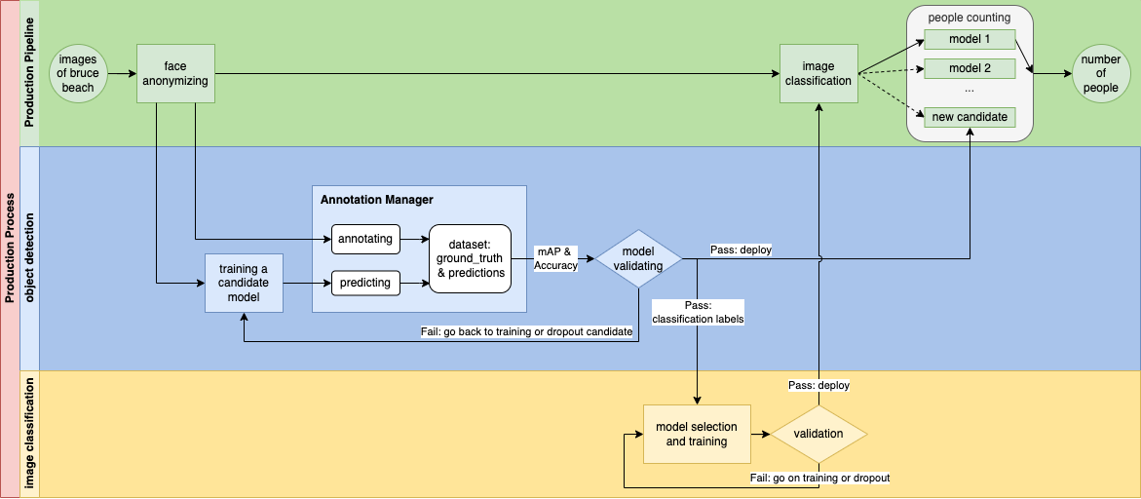

Slide 2
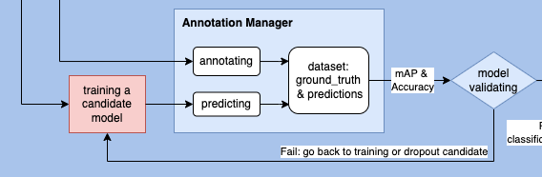
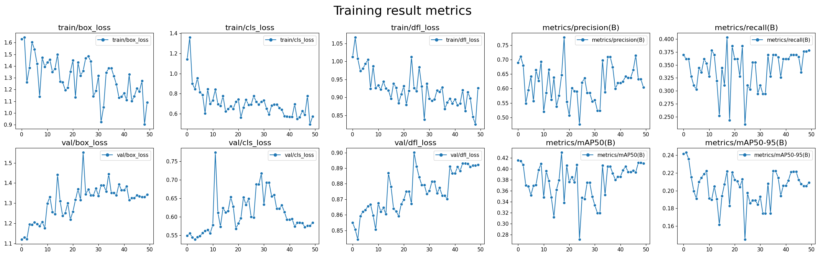
Model=YOLOv8, epochs=50, 50 epochs completed in 5.932 hours. 7.2 mins for each.

Slide 3

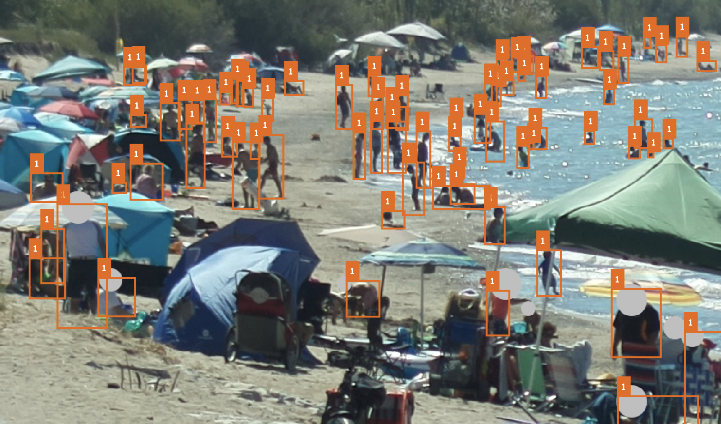
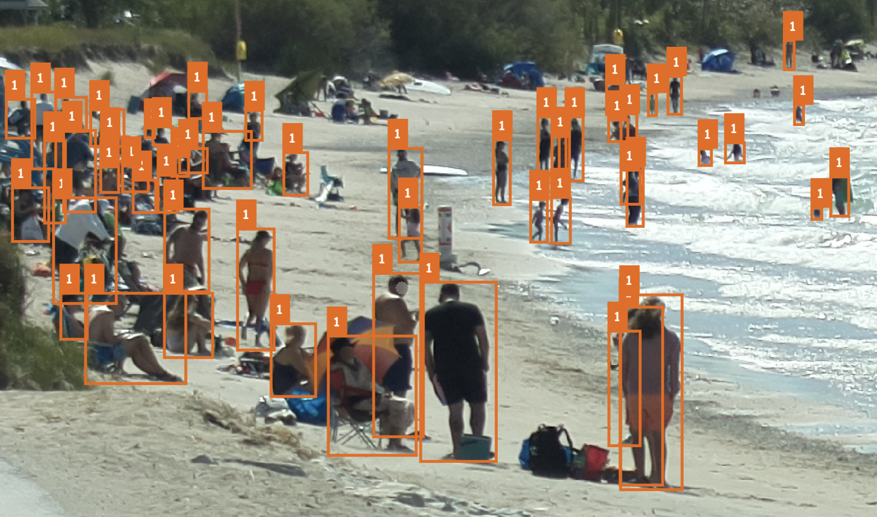
Picture3.png
2022-09-02_13-50-14.png

Slide 4
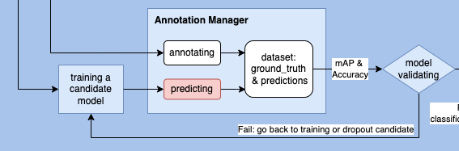
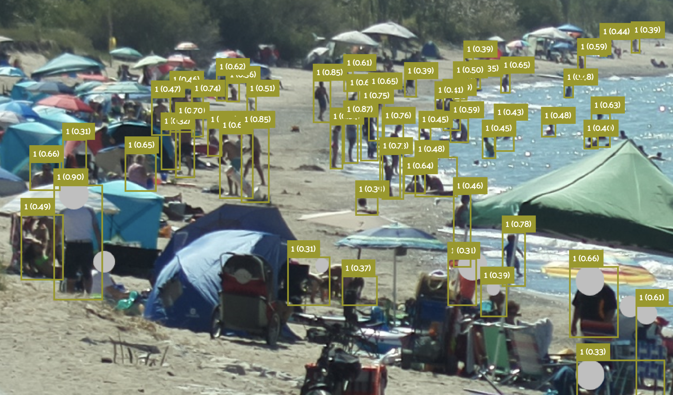
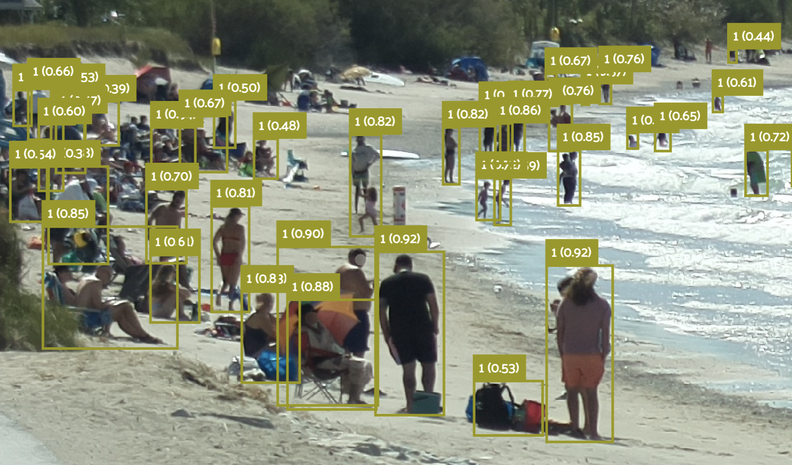
Picture3.png
2022-09-02_13-50-14.png

Slide 5
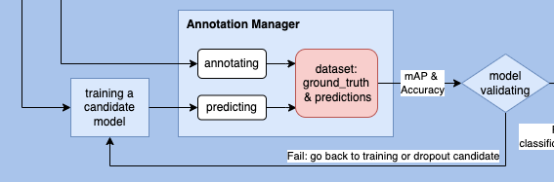
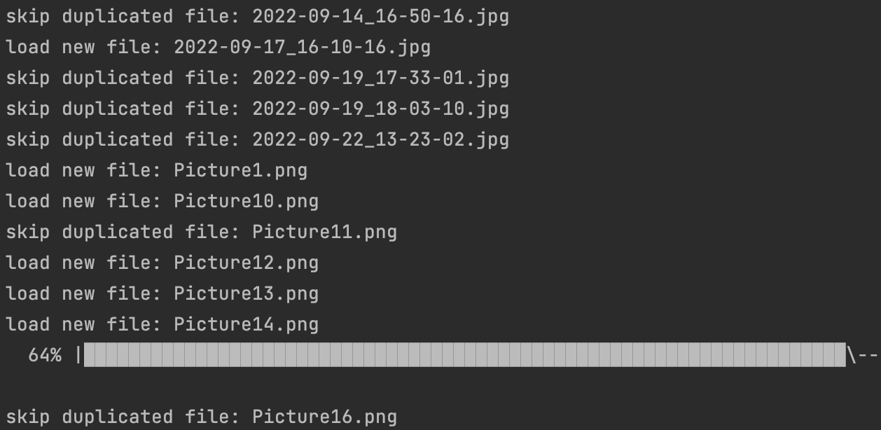
Incrementally update the ground_truth & predictions of new images

Slide 6
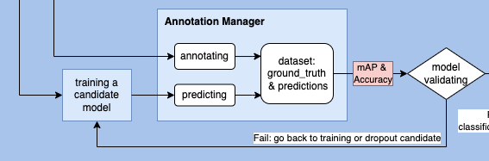
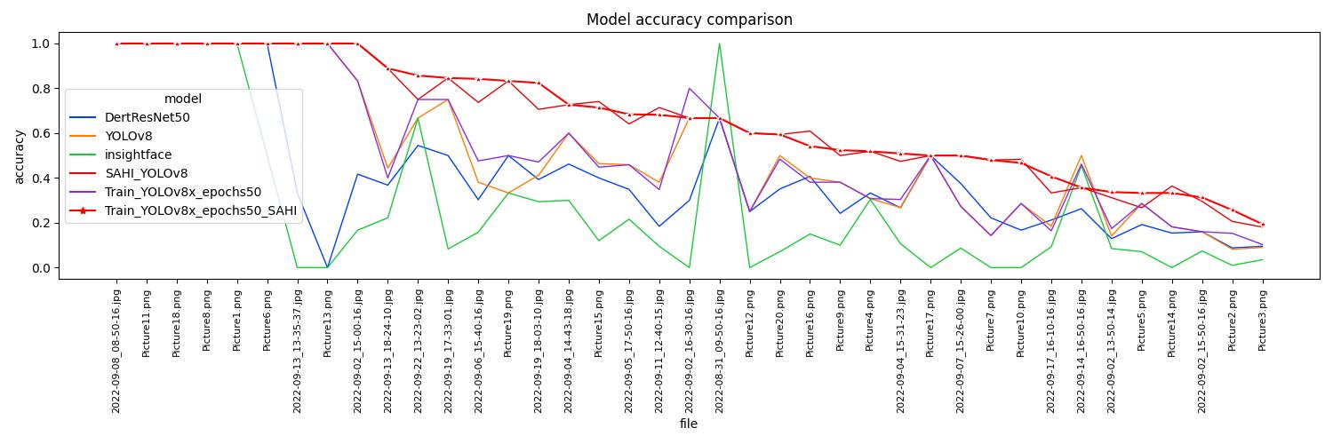

Slide 7
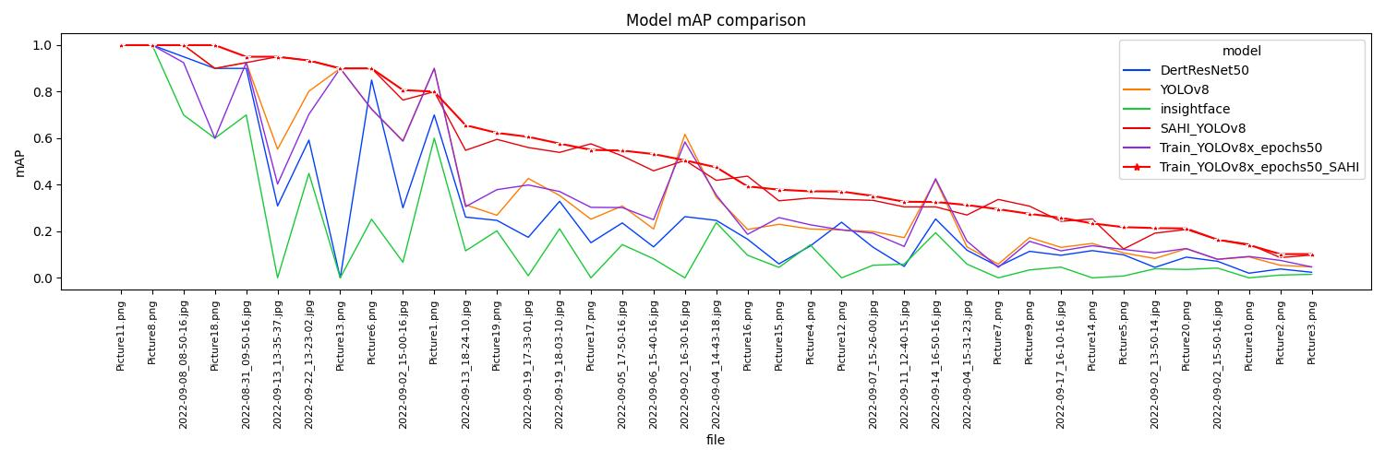

Slide 8


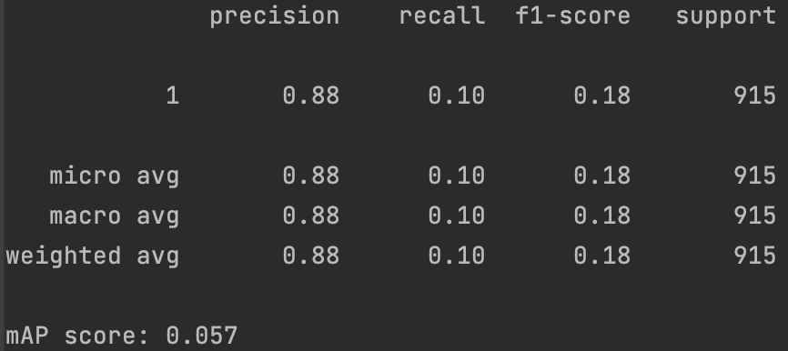
InsightFace

Slide 9
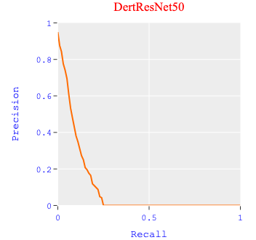
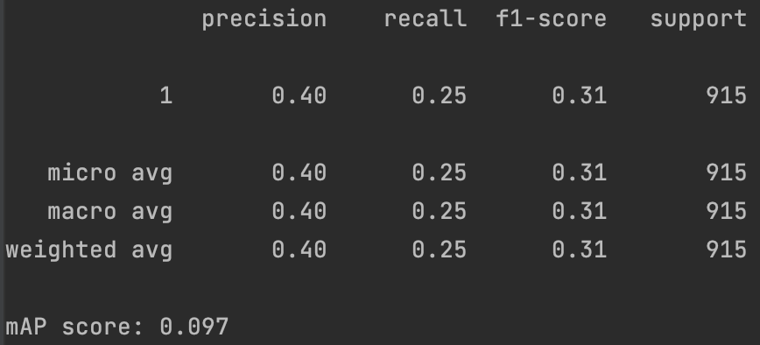
DertResNet50

Slide 10


YOLOv8

Slide 11

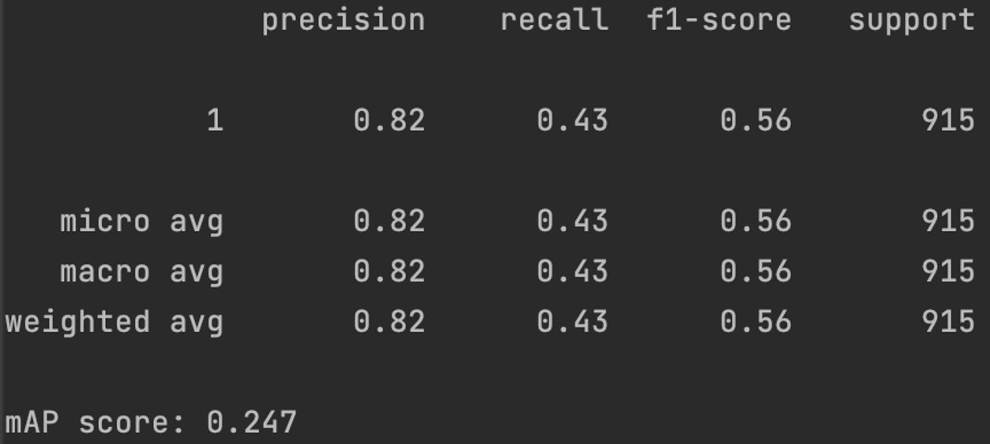
SAHI_YOLOv8

Slide 12

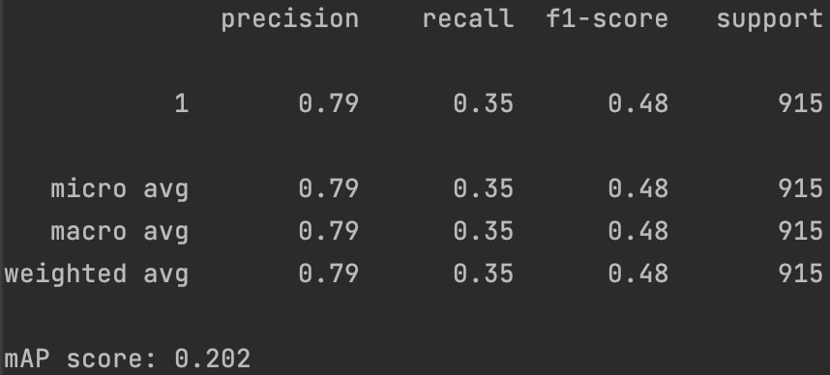
Train_YOLOv8x_epochs50

Slide 13
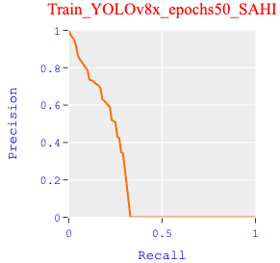
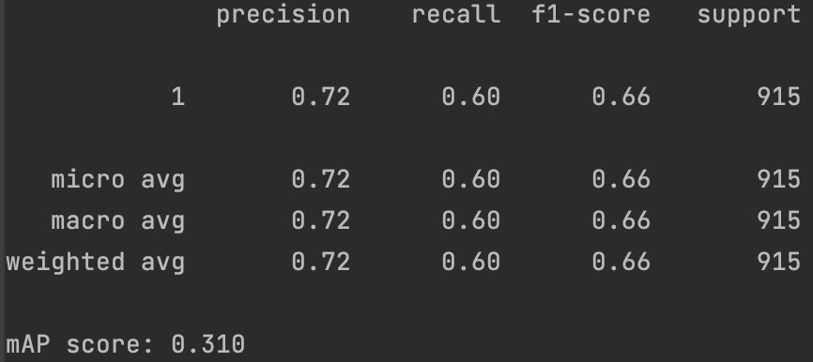
Train_YOLOv8x_epochs53_SAHI

Slide 14
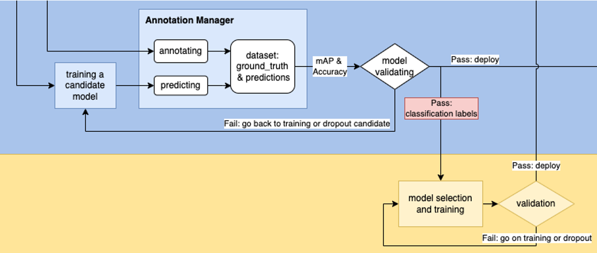
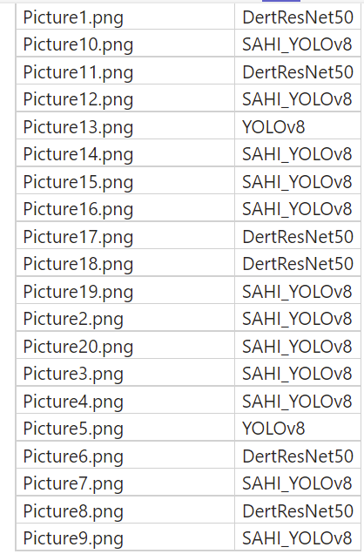
Publish the best models for each training image as a ground truth

Slide 15
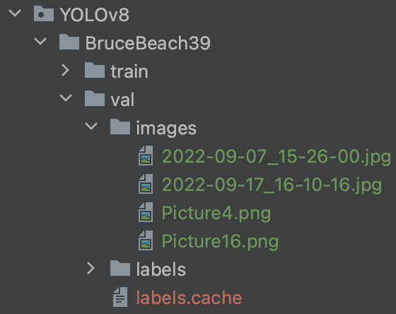
Require more training data
Only 4 images, 10% of all, can be used as validation data
SAHI + Training: this is the most desirable progress in this work
But more training data is required to train a more robust model

Slide 17
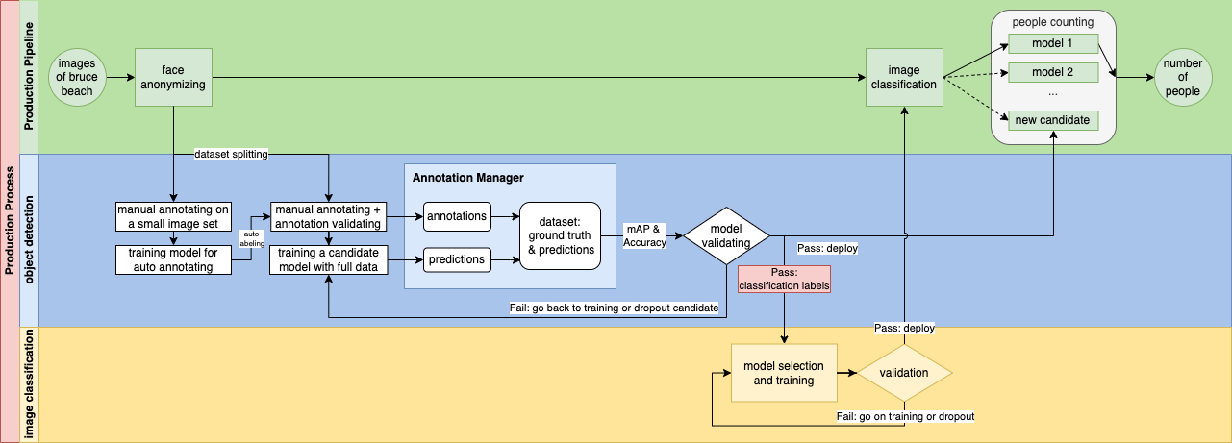

Slide 18
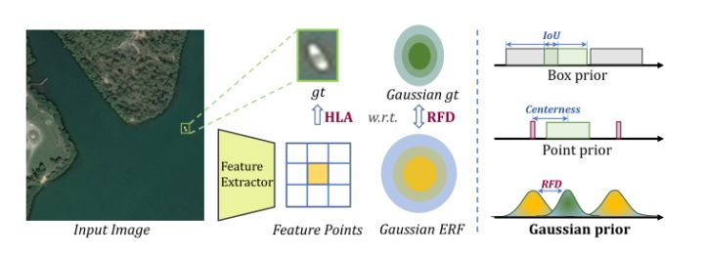
微小目标检测：AI-TOD[49]
https://blog.csdn.net/KANG157/article/details/126505149

Slide 19
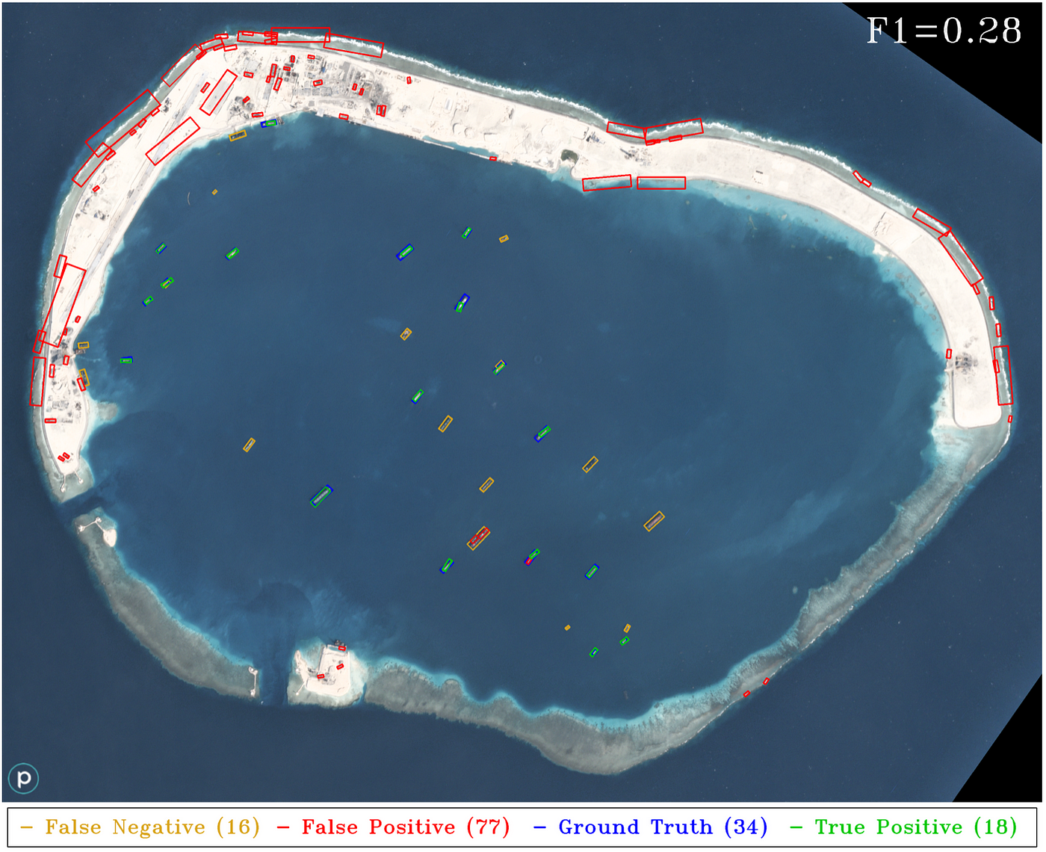
You Only Look Twice — Multi-Scale Object Detection in Satellite Imagery With Convolutional Neural Networks (Part I) https://medium.com/the-downlinq/you-only-look-twice-multi-scale-object-detection-in-satellite-imagery-with-convolutional-neural-38dad1cf7571

Slide 20
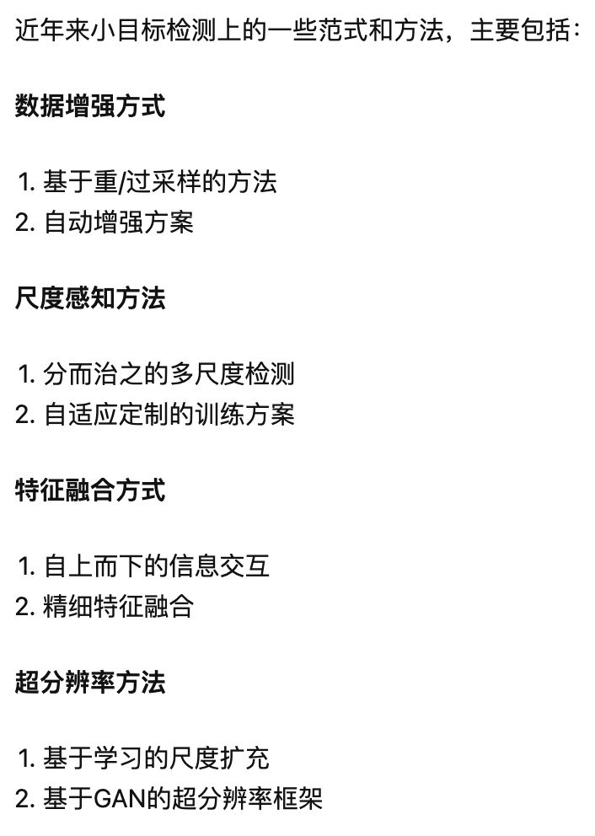
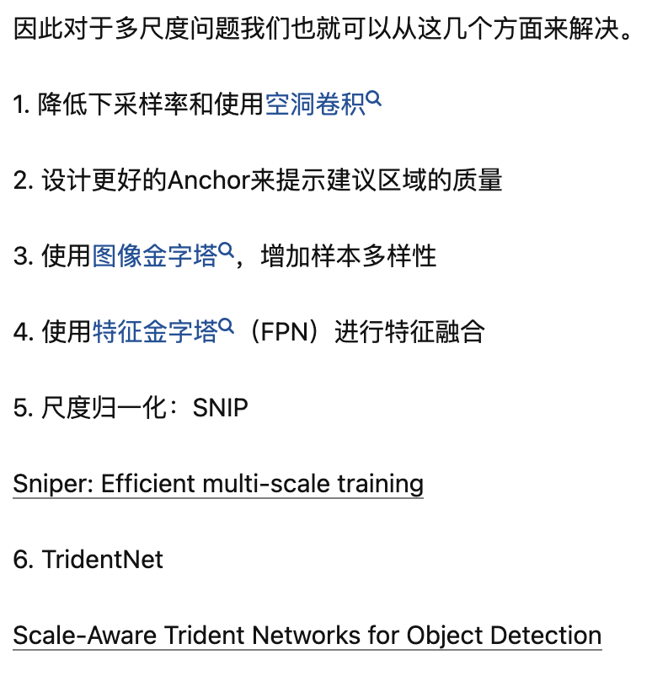
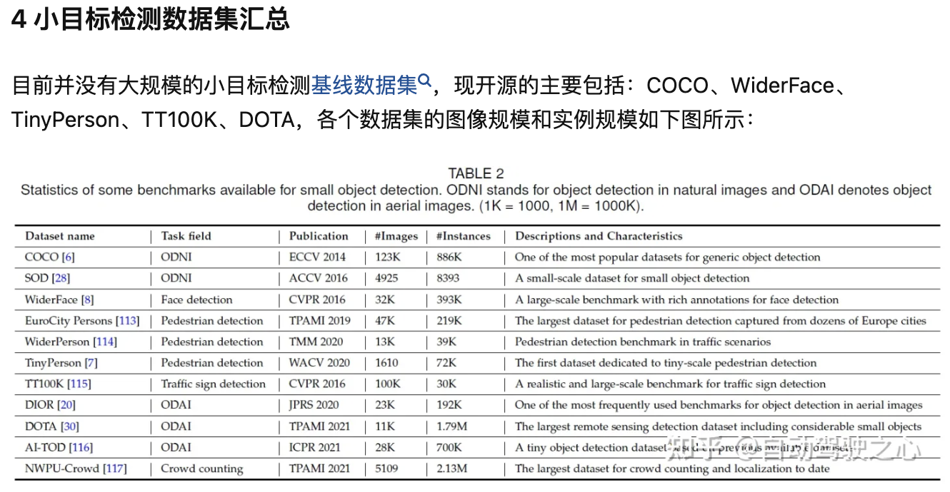
小目标检测问题中“小目标”如何定义？其主要技术难点在哪？有哪些比较好的传统的或深度学习方法？
https://www.zhihu.com/question/269877902

Slide 21
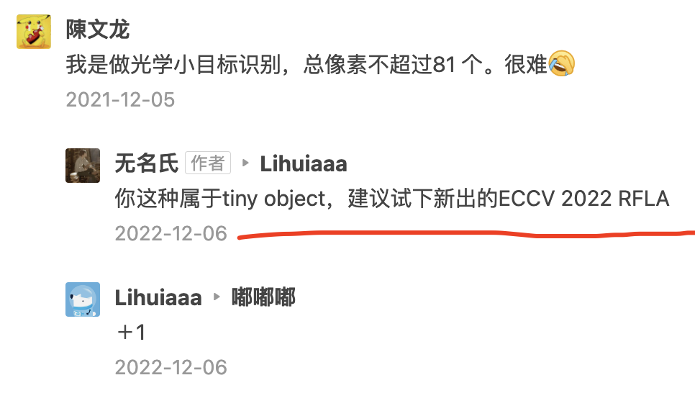
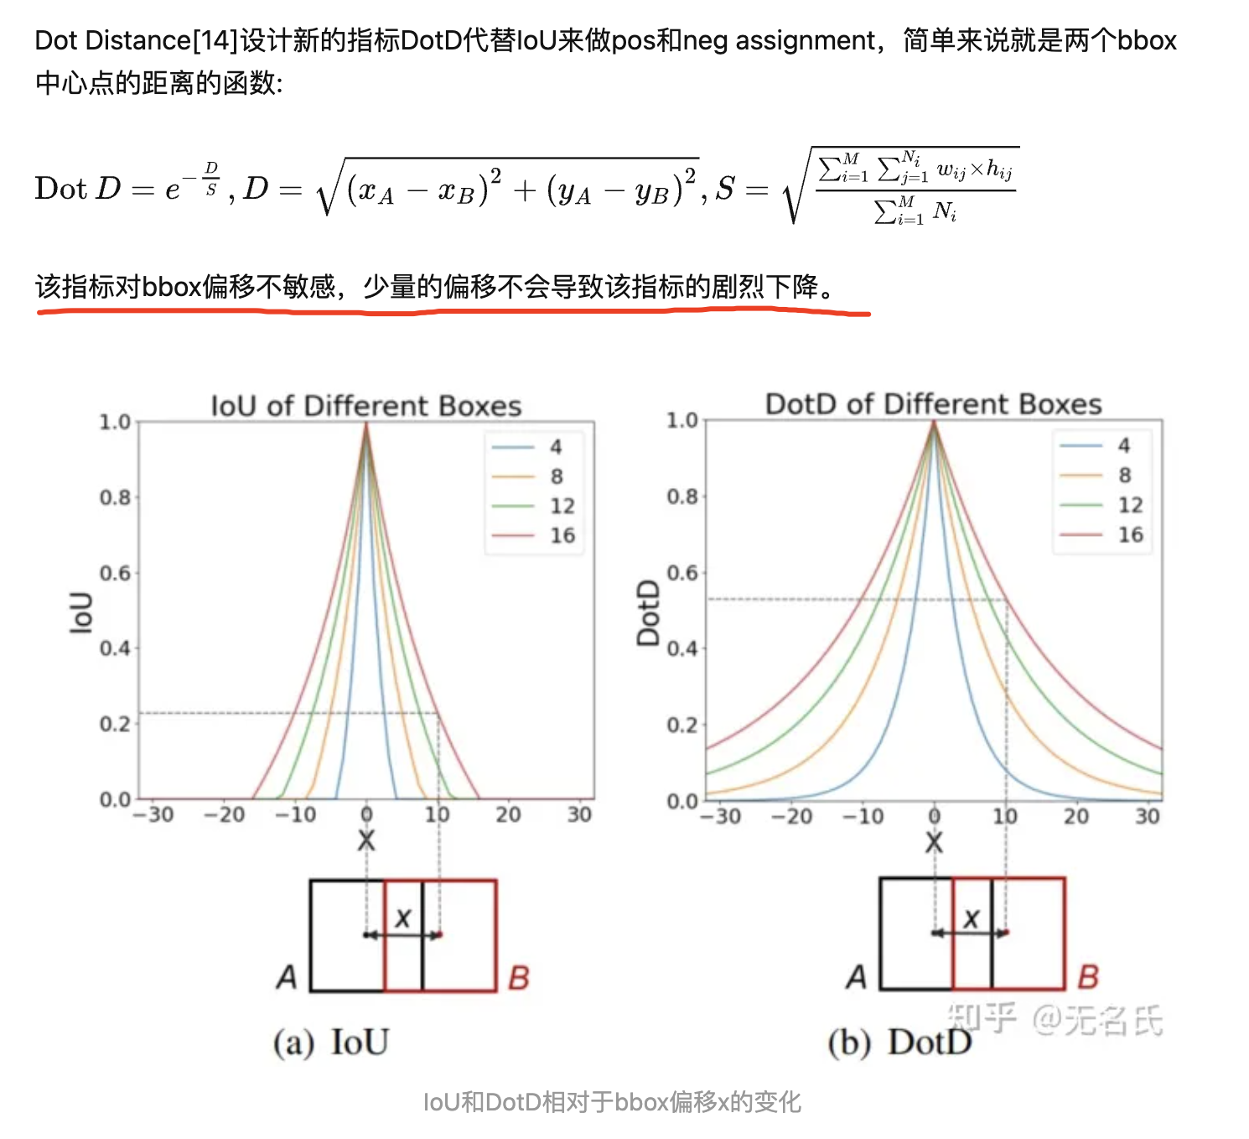
目标检测之殇——小目标检测
https://zhuanlan.zhihu.com/p/426047353

Slide 22
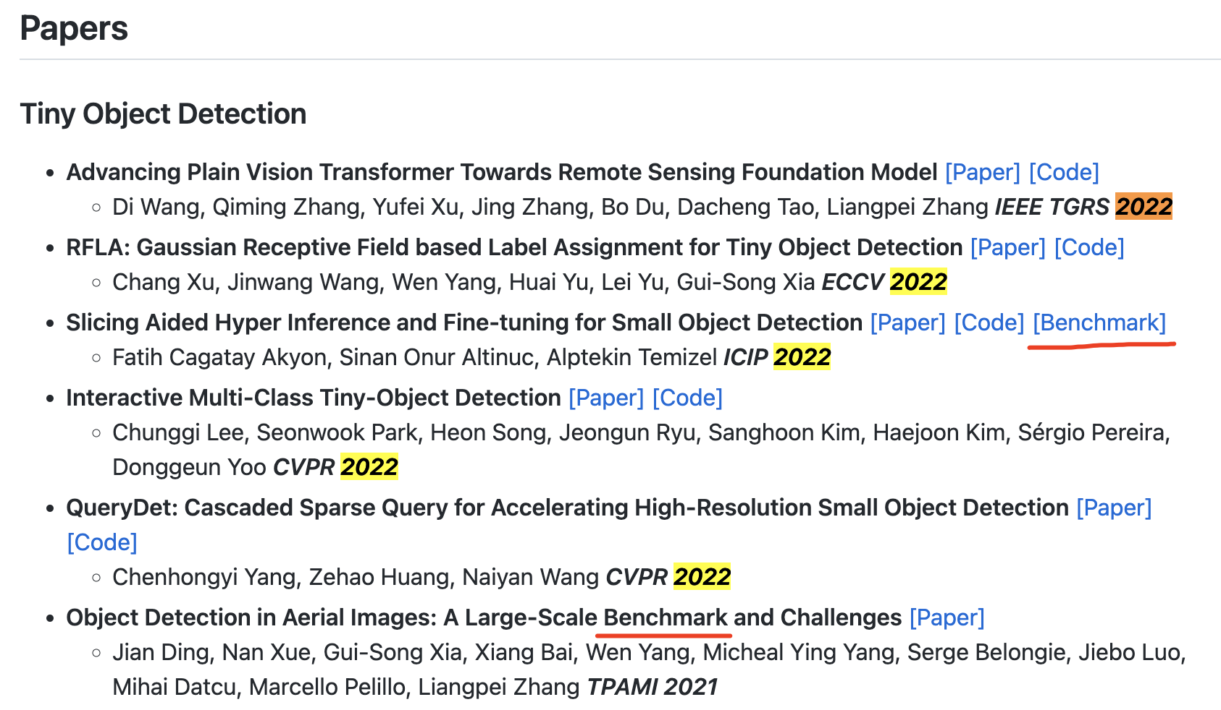
Awesome Tiny Object Detection
https://github.com/kuanhungchen/awesome-tiny-object-detection

Slide 23
https://app.cvat.ai/tasks/111493/jobs/110078?frame=151

